Slide 1


SQL AND NOSQL DATABASES
Subjects : Big Data Technologies
Presented by : Jenil Arvindbhai Paladiya
Matriculation Number : 4243558

Slide 2
INDEX
01
What are Databases?
02
Key Differences Between SQL and NoSQL Databases
03
Database Architecture for the Use Case
04
Why NoSQL Became Popular for Big Data Systems
05
SQL Advantages and Drawbacks
06
NOSQL Advantages and Drawbacks
07
Future Trends for SQL and NoSQL Databases
08
ACID vs. BASE for SQL and NoSQL
09
Real-World Use Case - Software Company Example
10
Conclusion and Key Takeaways

Slide 3
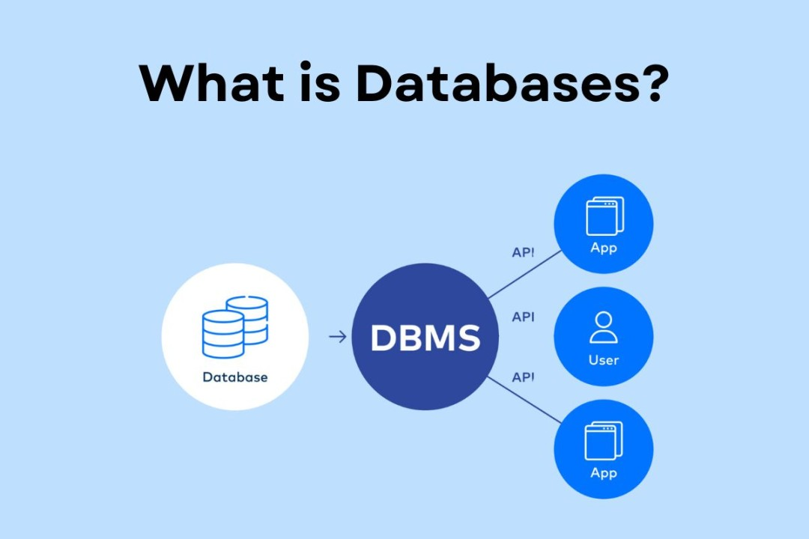
WHAT ARE DATABASES?
Definition: Databases store, organize, and manage digital data essential for businesses, websites, and software applications
Examples: Social media platforms, online stores, and banking applications.
1. Databases in Emerging Technologies:
Artificial Intelligence (AI): Databases store the training data used to build AI models.
Internet of Things (IoT): Databases manage the massive streams of data generated by connected devices, like smart home systems or industrial sensors.
2. Databases and Data Security:
Databases play a critical role in protecting sensitive information, such as credit card details or personal identities, through encryption and access controls.
3. The Evolution of Databases:
From traditional relational databases to modern cloud-based and distributed systems.

Slide 4
KEY DIFFERENCES BETWEEN SQL AND NOSQL DATABASES
Category | SQL Databases | NoSQL Databases
Schema | Predefined and fixed | Dynamic and flexible
Data Model | Relational (tables) | Key-value, document, column, or graph
Query Language | Structured Query Language (SQL) | Varies by database (NoSQL APIs, JSON)
Scalability | Vertical (add more resources) | Horizontal (add more servers)
Performance | Complex queries | High write/read throughput
Use Cases | Financial systems, ERPs | Real-time analytics, social media, IoT
Databases | Oracle, Microsoft SQL Server | Firebase, Redis, Couchbase

Slide 5
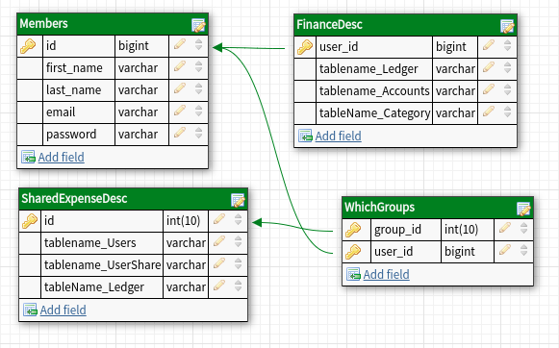
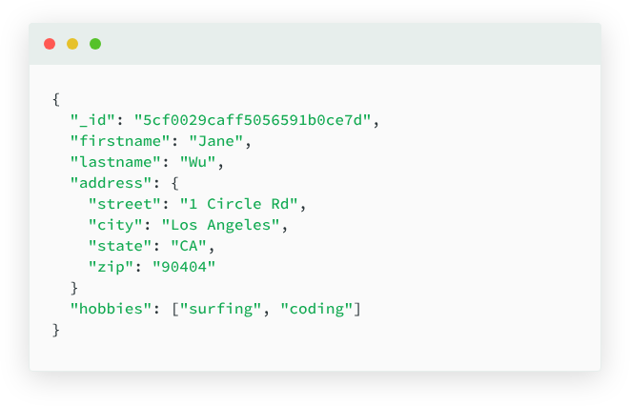
DATABASE ARCHITECTURE FOR THE USE CASE
SQL Database (MySQL):
Tables for structured storage
Schema for financial data (transactions, Members details)
NoSQL Database (MongoDB):
Document-based storage
Flexible schema using JSON/BSON formats

Slide 6
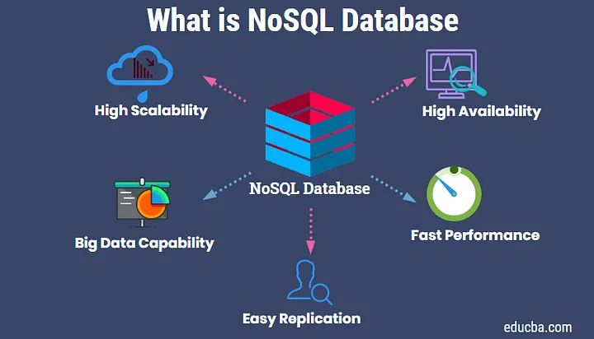
WHY NOSQL BECAME POPULAR FOR BIG DATA SYSTEMS
1 . High Scalability:
Horizontal scaling allows organizations to handle millions of simultaneous users by adding more servers.
3. High Availability:
Built-in fault tolerance and distributed architecture ensure minimal downtime.
2. Big Data Capacity:
Efficiently stores and processes massive volumes of structured and unstructured data.
4. Fast Performance:
Optimized for high-speed data read/write operations, ideal for dynamic applications like IoT or social media platforms.
5. Easy Replication:
Supports automatic replication for distributed environments, improving data redundancy and disaster recovery.

Slide 7
SQL ADVANTAGES AND DRAWBACKS
SQL (Relational Databases)
Advantages:
Data Integrity & Consistency: Strong ACID properties ensure reliable transactions.
Standardized Query Language: Universal use of SQL for querying and management.
Structured Data: Best for applications requiring complex relationships between data.
Established Ecosystem: Proven, mature tools with extensive community support.
Drawbacks:
Limited Scalability: Vertical scaling can become expensive and impractical.
Rigid Schema: Changes to data structure require downtime or migration.
Performance Bottlenecks: Slower with large-scale, write-heavy operations.

Slide 8
NOSQL ADVANTAGES AND DRAWBACKS
NoSQL (Non-Relational Databases)
Advantages:
High Scalability: Handles horizontal scaling seamlessly by adding servers.
High Availability: Built for fault-tolerant distributed systems.
Flexible Data Models: Supports evolving business needs without downtime.
Fast Performance: Optimized for high-speed read/write operations.
Drawbacks:
Consistency Issues: Eventual consistency may not suit critical systems.
Learning Curve: Developers need to adapt to various NoSQL data models.
Limited Standardization: Different databases require unique query languages and tools.

Slide 9
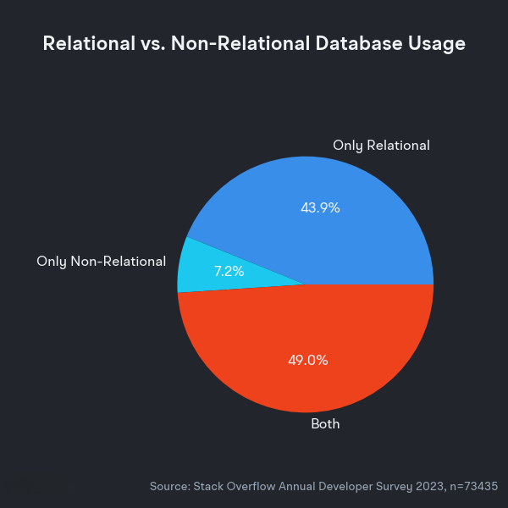
FUTURE TRENDS FOR SQL AND NOSQL DATABASES
1. Convergence of SQL and NoSQL:
NewSQL databases offering hybrid features (e.g., CockroachDB, Google Spanner)
2. Cloud-Native Databases:
Serverless solutions like AWS DynamoDB gaining traction
3. Machine Learning and AI Integration:
Databases optimized for AI-powered insights
4. Graph Databases:
Neo4j and Amazon Neptune for relationship-driven applications
5. Data Security Advancements:
Stricter compliance requirements driving secure NoSQL solutions

Slide 10
ACID VS. BASE FOR SQL AND NOSQL
ACID is better for scenarios where strict accuracy and reliability are critical (e.g., banking systems).
BASE is better suited for distributed systems requiring scalability and performance, where immediate consistency isn't essential (e.g., eCommerce or social media).
Concept | ACID (SQL) | BASE (NoSQL)
Atomicity | Transactions fully complete or fail | Eventual completeness
Consistency | Data always remains valid | Eventual consistency
Isolation | Transactions are isolated | Lesser isolation
Durability | Data changes persist | Changes eventually persist
Main Use Case | Banking, eCommerce | Social media, real-time analytics

Slide 11
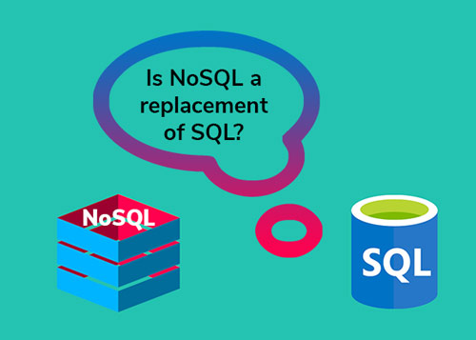
REAL-WORLD USE CASE - SOFTWARE COMPANY EXAMPLE
Scenario:
A SaaS (Software as a Service) company provides:
Financial transaction services for business clients
Social media insights and real-time analytics for marketing
Storage Solution:
SQL Database: MySQL for structured financial data
NoSQL Database: MongoDB for dynamic user interactions
Why This Hybrid Solution?
Consistency for SQL: Necessary for financial records to maintain accuracy
Scalability for NoSQL: Handling large volumes of real-time analytics data

Slide 12
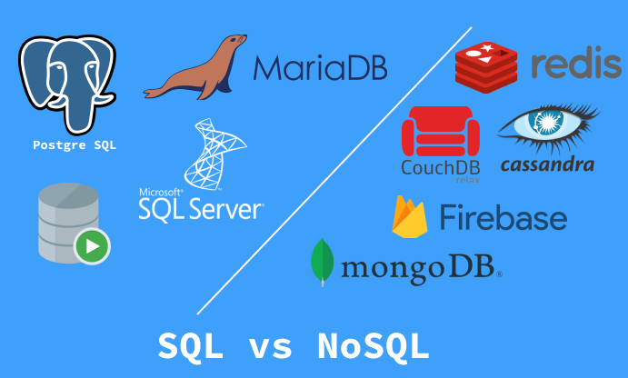
CONCLUSION AND KEY TAKEAWAYS
Choosing the right database technology is key to building efficient, scalable, and future-ready software systems.
1. Hybrid Approach:
Most companies adopt both SQL and NoSQL databases to maximize efficiency.
2. SQL and NoSQL Differences:
SQL provides robust, consistent storage for structured data.
NoSQL excels in dynamic, scalable systems.
3. Final Thought:
A successful database strategy depends on understanding business requirements and selecting the right storage solutions for different components of the application.

Slide 13
THANK YOU

